Slide 1
The battle of neighborhoods
Butterscotch Pancakes restaurant

Slide 2

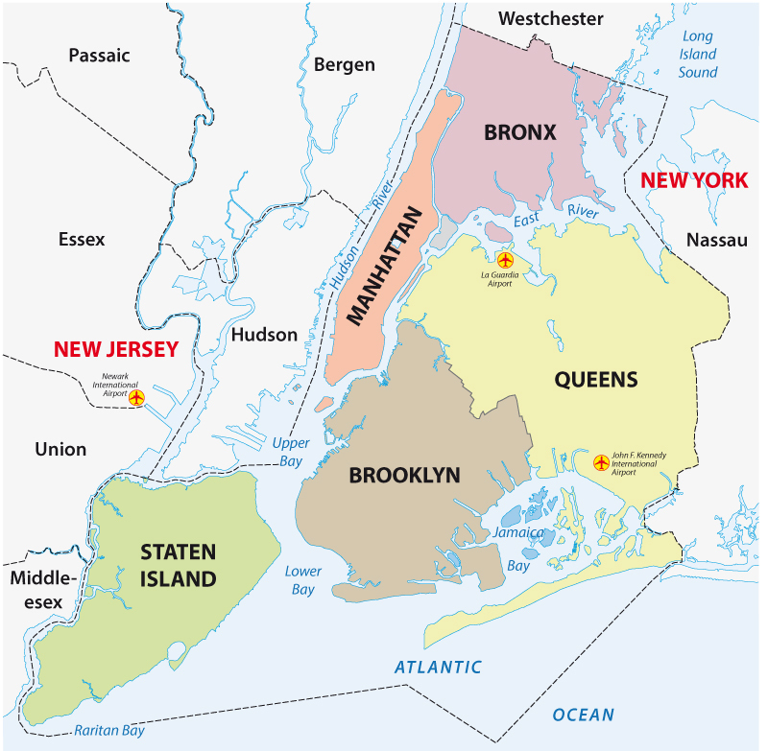


Introduction
"Butterscotch Pancakes" – Russian chain of restaurants
CEO of the chain wants to open his first restaurant in the US
Our goal is to find an optimal location for the Restaurant
Business problem
The food market in NY is highly competitive
Need a thorough market analysis
Looking for a place with a highest demand and low competition

Slide 3
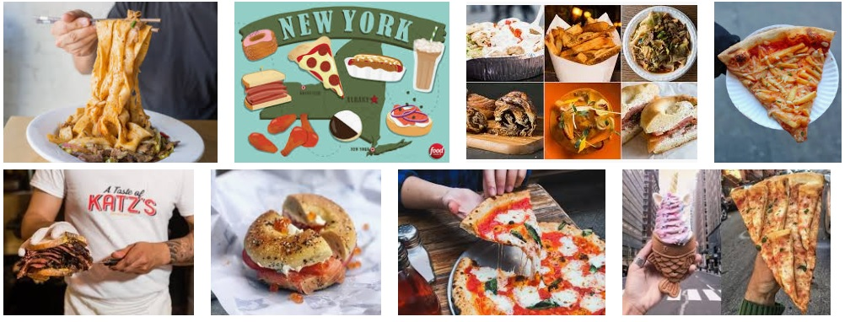
Competitors
Fast food (hot dogs, bagels, ice cream, burgers etc.)
Italian restaurants
Asian restaurants (Thai, Chinese, Indian etc.)
Coffee shops
Middle Eastern restaurants

Slide 4
Factors to study
New York Population
New York City Demographics
Sources of ingredients
Popular attractions nearby
Competitors
Segmentation of neighborhoods (Boroughs)
The objective of this project is to deliver a recommendation of which neighborhood of NY will be the best choice to build the restaurant

Slide 5
Data description
To complete our goal we will gather and analyze the following data:
1 - New York City Neighborhood names (https://geo.nyu.edu/catalog/nyu_2451_34572)
2 - The list of farmers market of NY (https://data.cityofnewyork.us/dataset/DOHMH-Farmers-Markets/8vwk-6iz2)
3 - Location data of Fresh food box. Fresh Food Box Program is a food access initiative that enables under-served communities to purchase fresh, healthy, and primarily regionally grown produce well below traditional retail prices (https://www.grownyc.org/greenmarketco/foodbox)
4 - Wikipedia (data on population, economy, demographics, cuisine etc.)
5 - Foursquare API.

Slide 6
Analytic approach
1. We load and explore the data from newyork_data.json file.
2. Transform the data into a pandas dataframe.
3. This dataframe contains the geographical coordinates of New York city neighborhoods.
4. This data will be used to get Venues data from Foursquare with its API.
5. We used Geopy and Folium libraries to create a map of New York city with neighborhoods

Slide 7
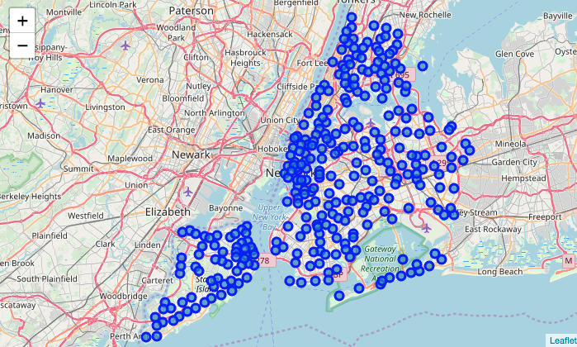
Methodology
New York Neighborhood visualization

Slide 8
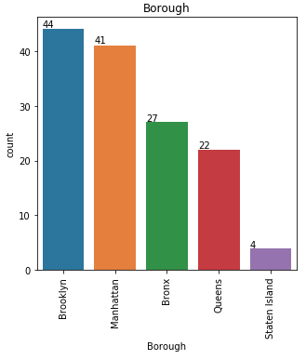
Farmers market distribution via 5 Boroughs
There are totally 138 Farmers Markets in New York city.
Highest number are in Manhattan and Brooklyn. And lowest in Queens, Bronx and Staten Island.

Slide 9
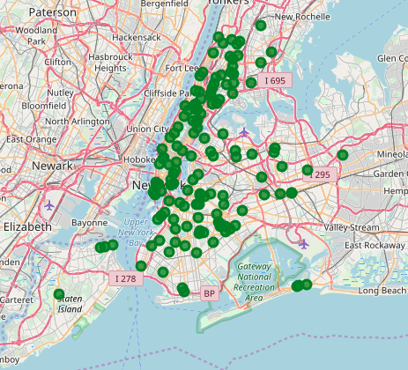
Map of farmers markets in New York city

Slide 10
New York Population
Insights from the data:
Manhattan (New York County) is the geographically smallest and most densely populated borough.
Manhattan's (New York County's) population density of 72,033 people per square mile (27,812/km²) in 2015 makes it the highest of any county in the United States and higher than the density of any individual American city.
Brooklyn (Kings County), on the western tip of Long Island, is the city's most populous borough.
Queens (Queens County), on Long Island north and east of Brooklyn, is geographically the largest borough.

Slide 11
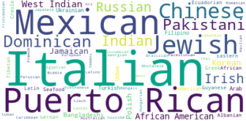
New York Cuisine
This data has been manually sourced from Wikipedia page - https://en.wikipedia.org/wiki/Cuisine_of_New_York_City .
Using this data we created word cloud.
NEW YORK CITY CUISINE: Most Preferred Food in New York City – Italian, Mexican, Puerto Rican, Jewish, Chinese.

Slide 12
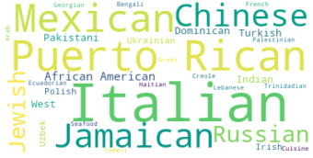
New York Cuisine
BROOKLYN CUISINE - Most Preferred Food in Brooklyn is – Italian, Puerto Rican, Mexican, Chinese, Jamaican and Russian.

Slide 13
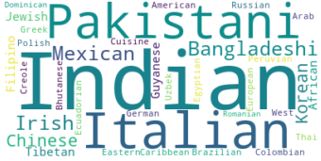
New York Cuisine
MANHATTAN CUISINE - Most Preferred Food in Manhattan is – Indian, Pakistani, Italian.

Slide 14
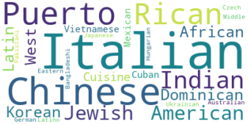
New York Cuisine
QUEENS CUISINE - Most Preferred Food in Queens is – Italian, Chinese, and Puerto Rican.

Slide 15
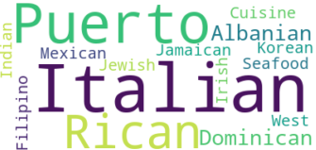
New York Cuisine
THE BRONX CUISINE - Most Preferred Food in The Bronx is – Italian and Puerto Rican.

Slide 16
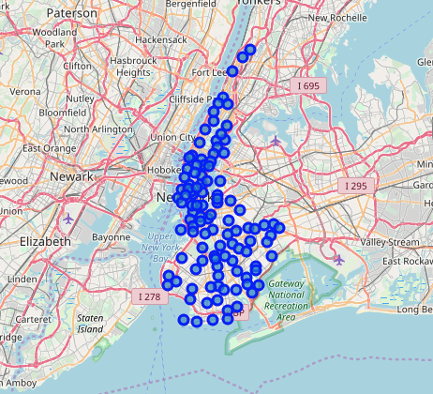
Exploring the neighborhoods in New York City
New York city geographical coordinates data has to be utilized as input for the Foursquare API, that has been leveraged to provision venues information for each neighborhood. We used the Foursquare API data to explore neighborhoods in New York City.
Brooklyn and Manhattan Venues Visualization: Generated the below Brooklyn and Manhattan Venues Visualization. The "BM_venues" dataframe has 9670 venues and 407 unique venue types.

Slide 17
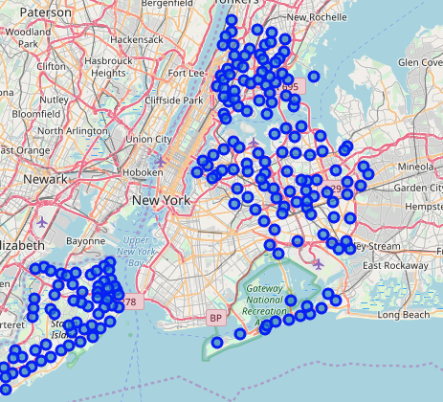
Bronx, Queens and Staten Island Neighborhoods Visualization
The "BQS_venues" dataframe has 10911 venues and 395 unique venue types.

Slide 18
Results
From this venues data we filtered and used only the restaurant data for Brooklyn & Manhattan clustering and Bronx, Queens and Staten Island clustering. As we focused only on restaurants business.
Neighborhood K-Means clustering based on mean occurrence of venue category.
To cluster the neighborhoods into two clusters we used the K-Means clustering Algorithm. k-means clustering aims to partition n observations into k clusters in which each observation belongs to the cluster with the nearest mean. It uses iterative refinement approach.

Slide 19
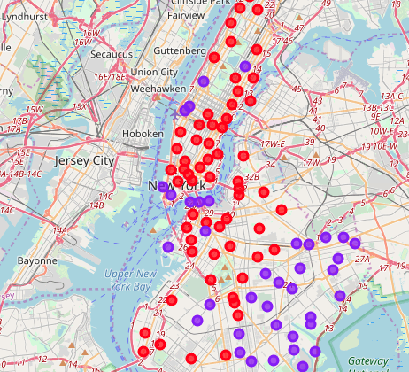
Brooklyn & Manhattan:
In the Map Visualization, we can see the different types of clusters created by using K-Means for Brooklyn & Manhattan.
Cluster0 : The Total and Total Sum of cluster0 has smallest value. It shows that the market is not saturated.
Cluster1 : The Total and Total Sum of cluster1 has highest value. It shows that the markets are saturated. Number of restaurants are very high.
There are no untapped neighborhoods in Brooklyn and Manhattan.

Slide 20
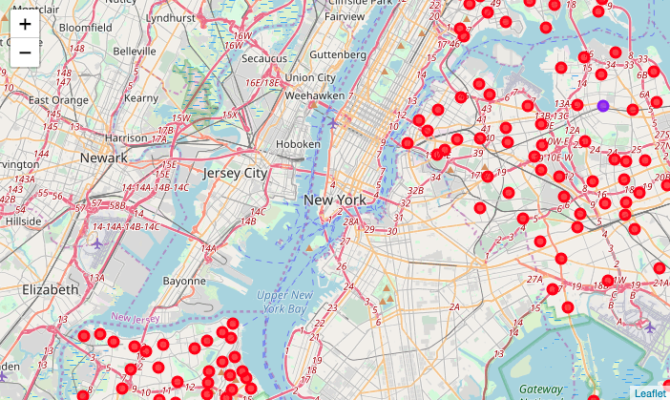
Bronx, Queens and Staten Island:
In the below Map Visualization, we can see the different types of clusters created by using K-Means for Bronx, Queens and Staten Island.
Cluster0: The Total and Total Sum of cluster0 has smallest value. It shows that the market is not saturated. There are untapped neighborhoods.

Slide 21
Discussion
1. There is scope to increase Farmers markets in Bronx, Queens and Staten Island.
2. In Manhattan and Brooklyn restaurants of cuisines of many countries are available. It shows that people love eating cuisines of various countries. Or there is very high density of people with different nationalities.

Slide 22
Conclusion
To conclude it should be mentioned that the analysis performed on limited data. Therefore, there may be incorrect clustering results. Brooklyn and Manhattan have high concentration of restaurant business and very competitive market.
Regarding our objective, based on data and analysis it may be stated that a perfect place to start "Butterscotch Pancakes" restaurant is Brooklyn (probably due to a high concentration of ex-soviet people living there).

